Slide 1

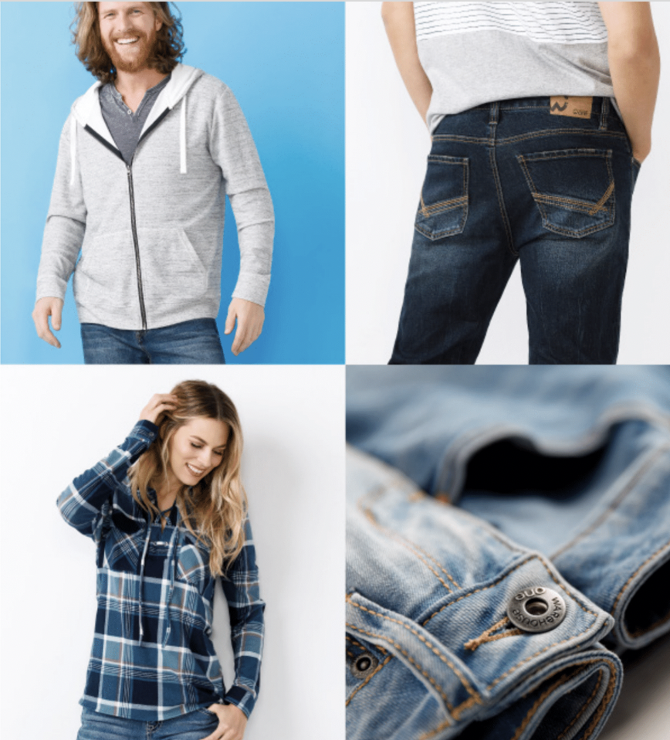

Slide 2
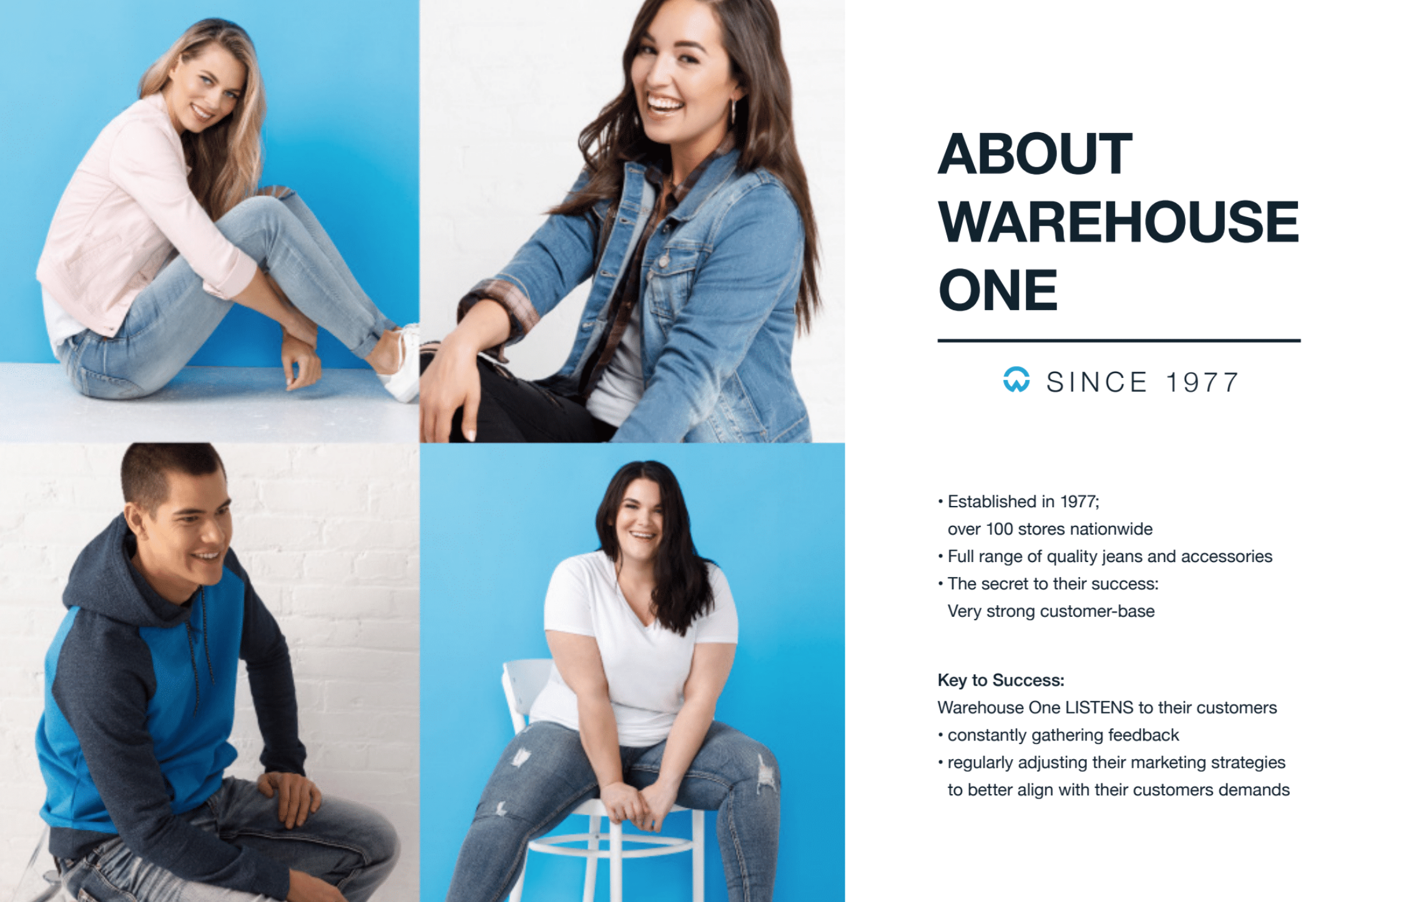

Slide 3
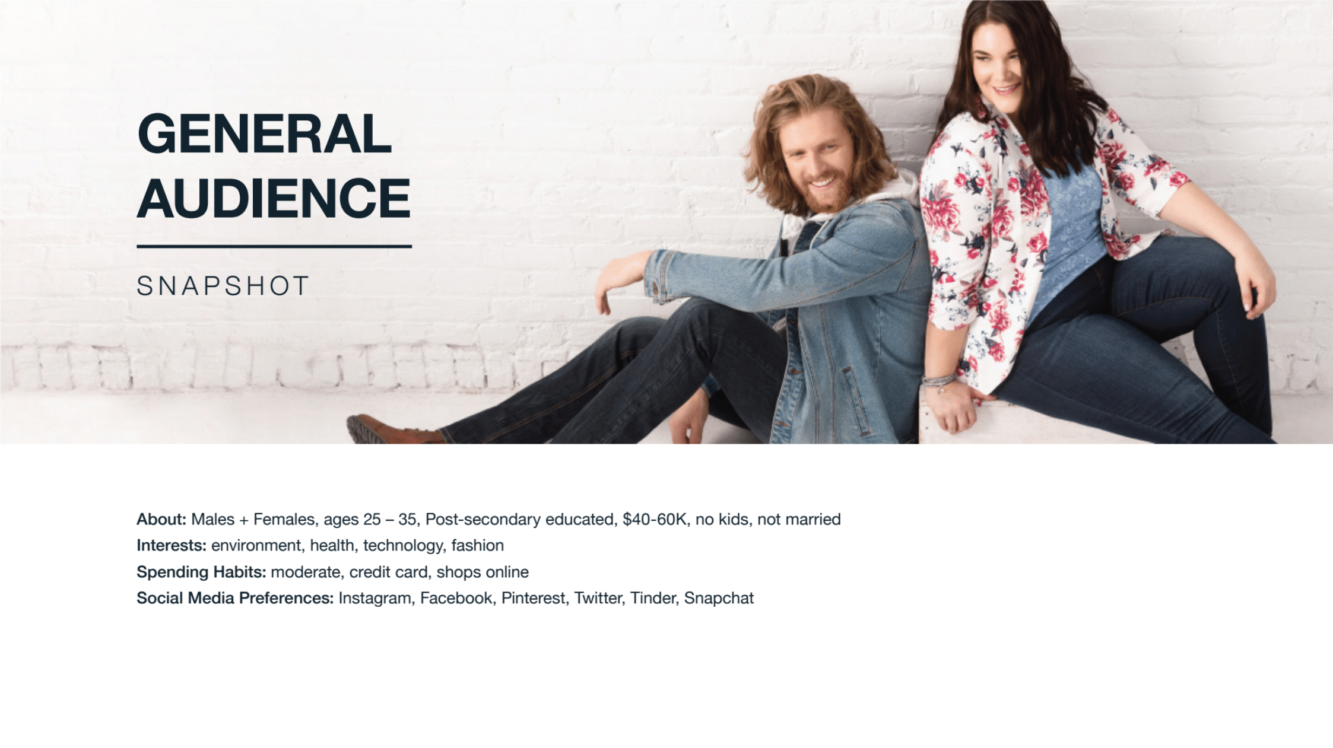

Slide 4
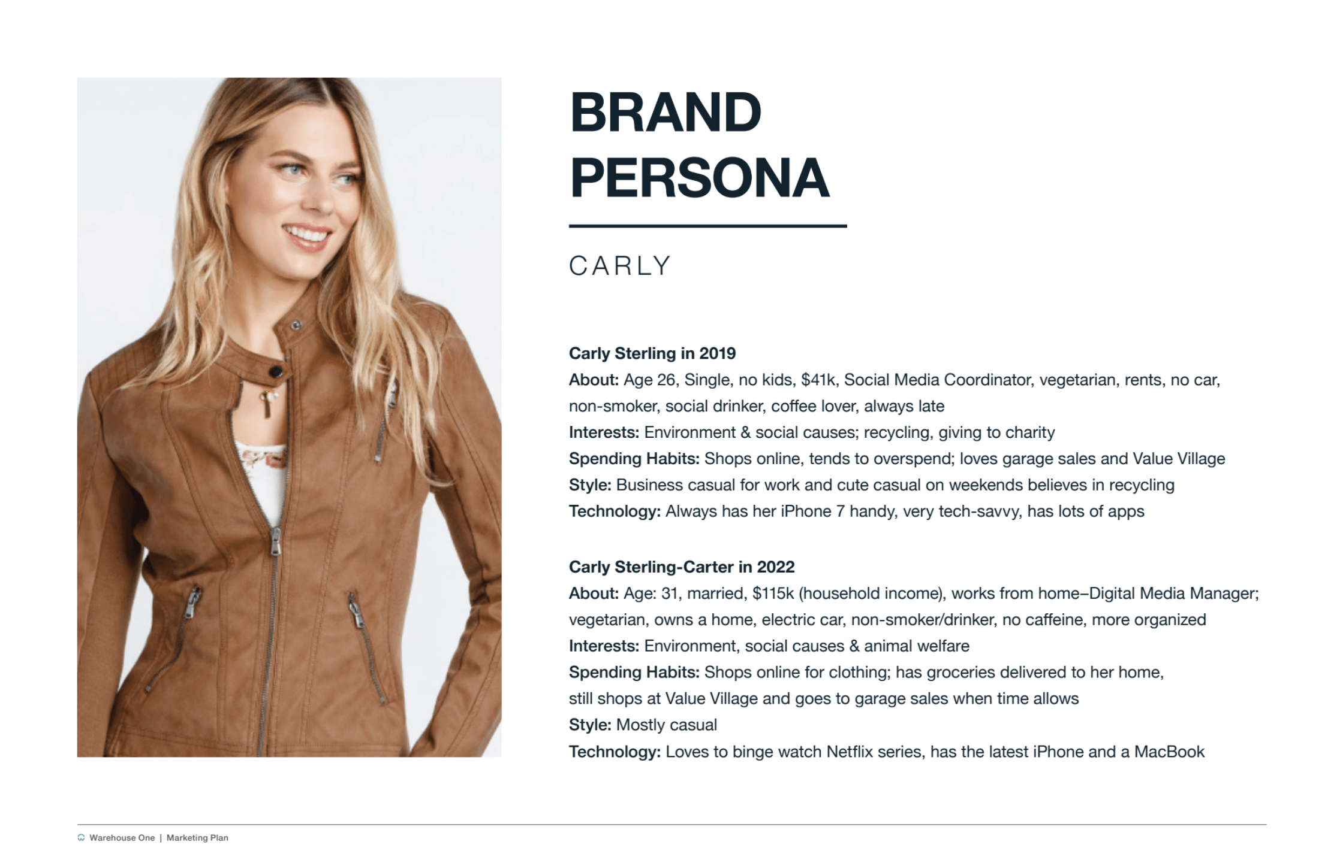

Slide 5
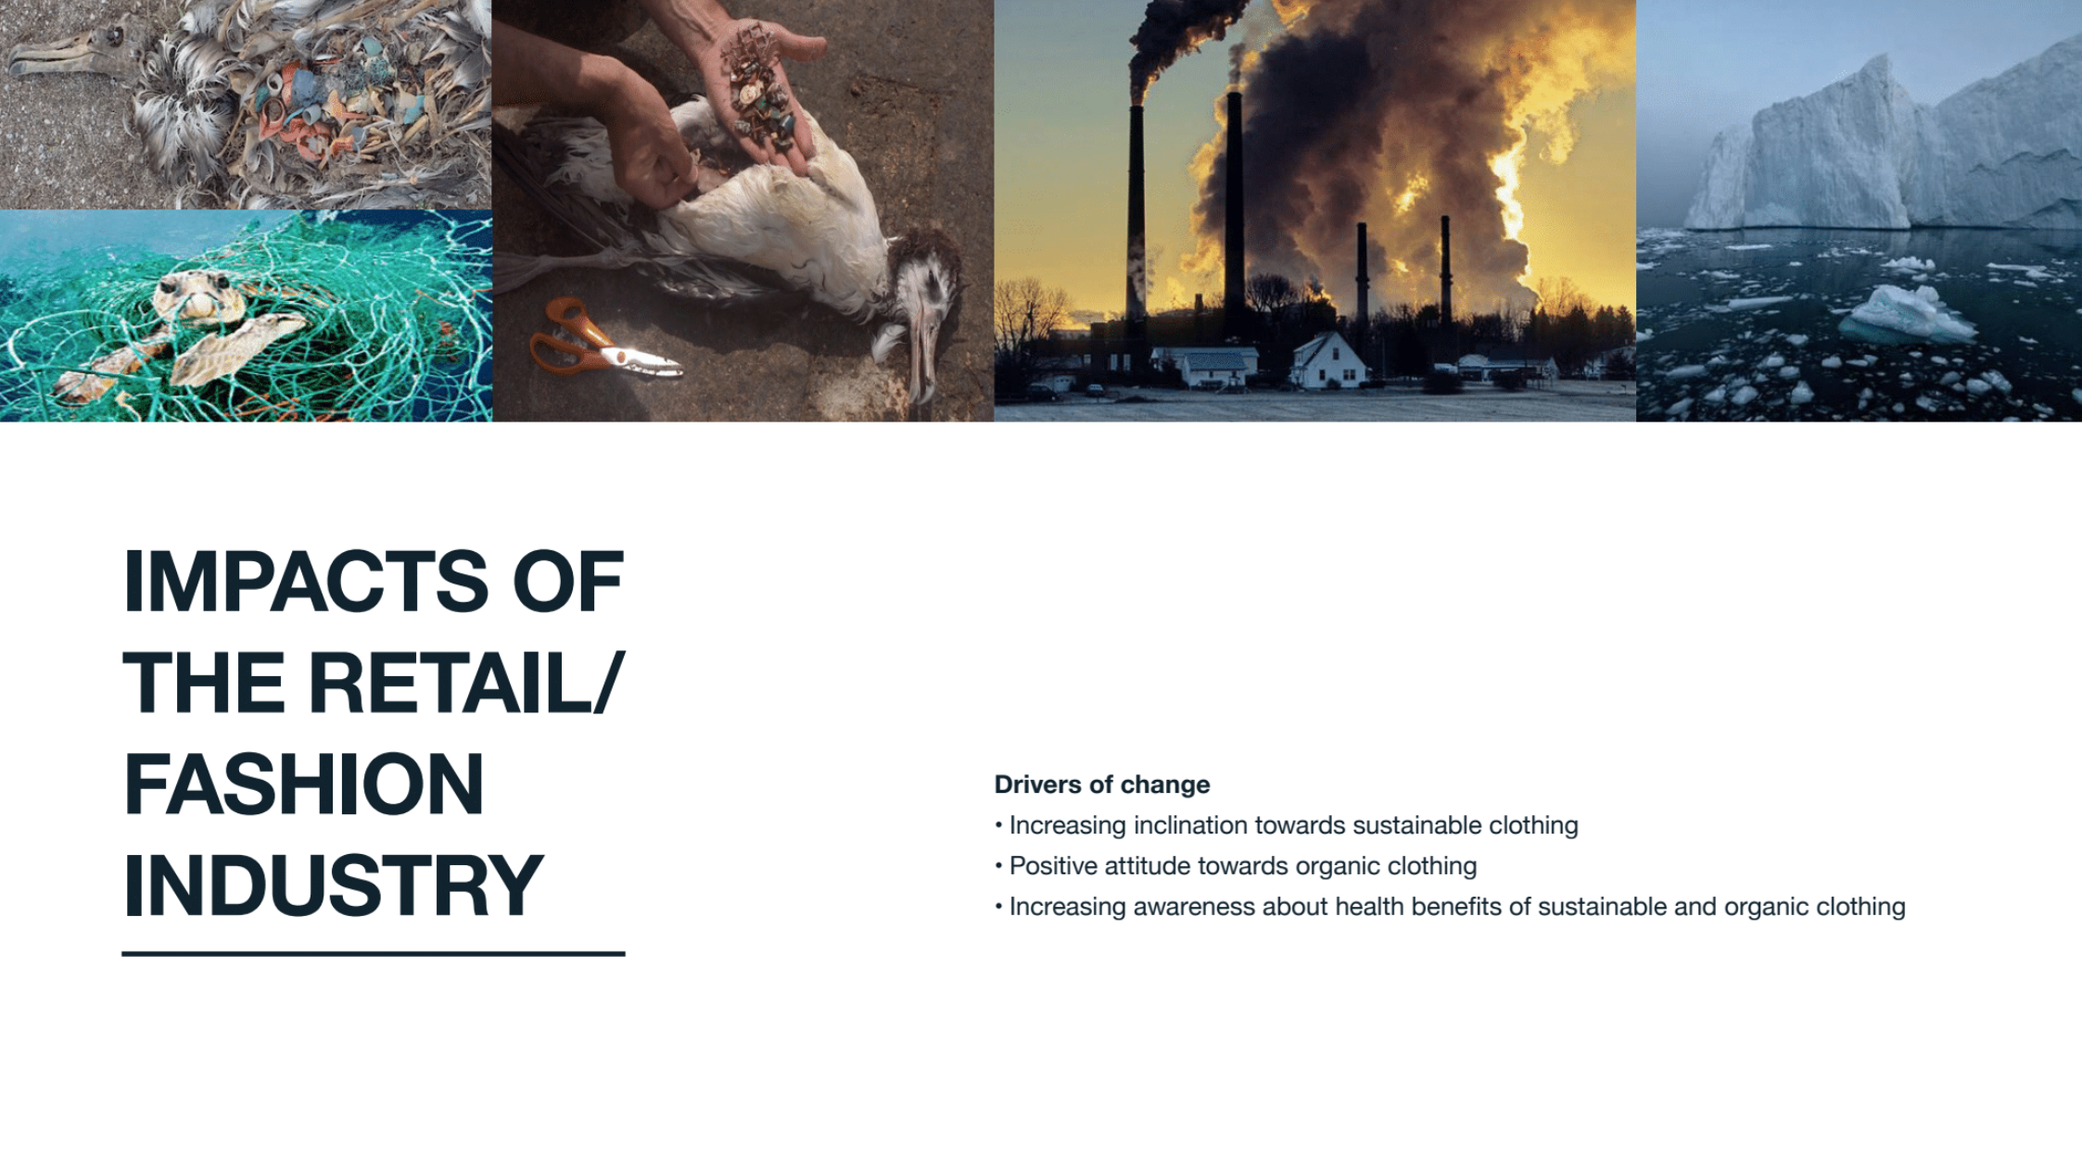

Drivers of Change
Increasing inclination towards sustainable Clothing
Positive attitude towards organic clothing
Increasing awareness about health benefits of sustainable and organic clothing

Slide 6
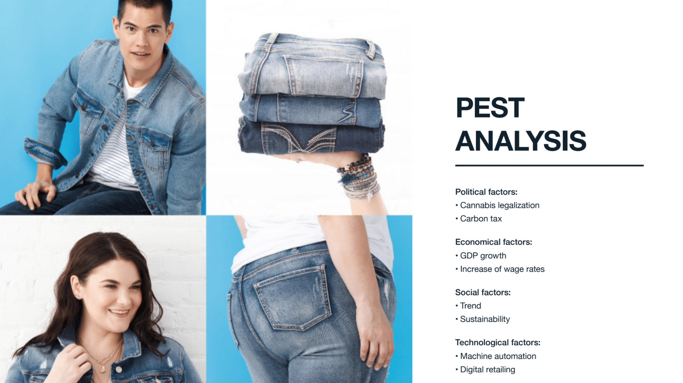

Slide 7
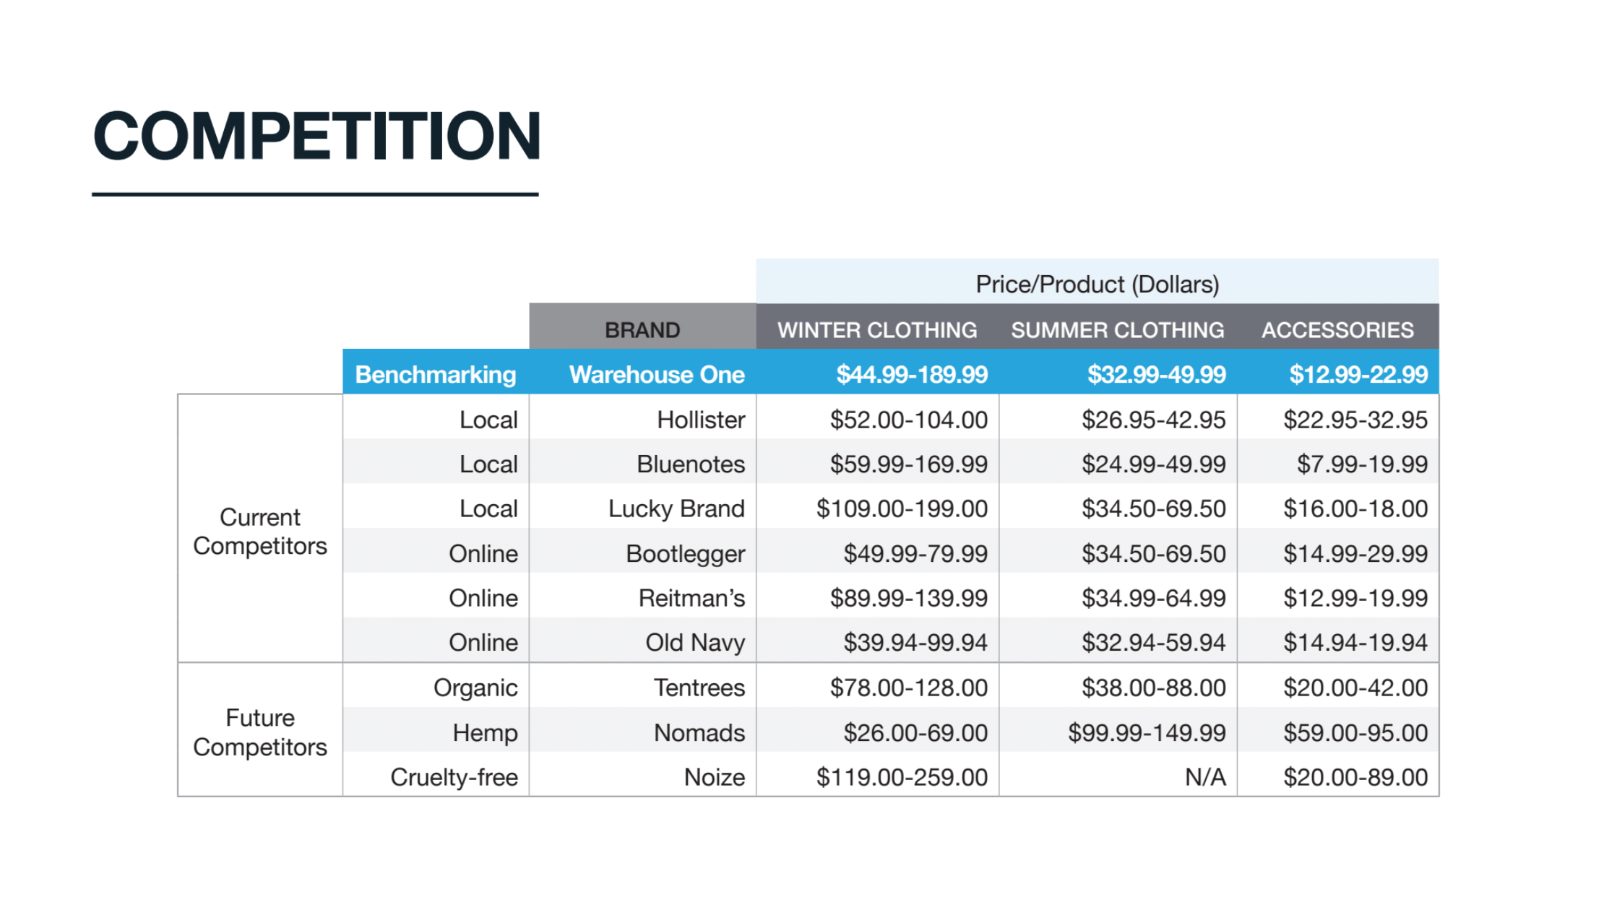

Slide 8
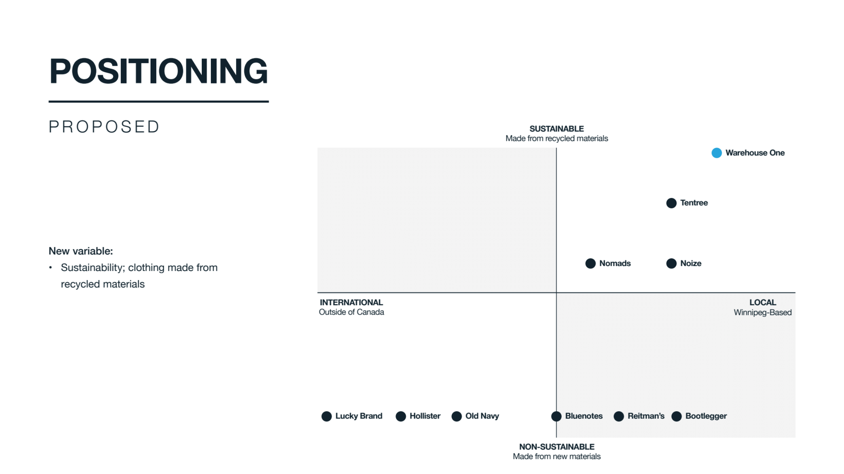

Slide 9
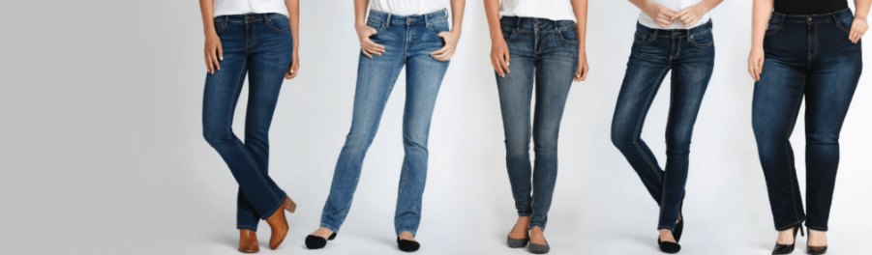

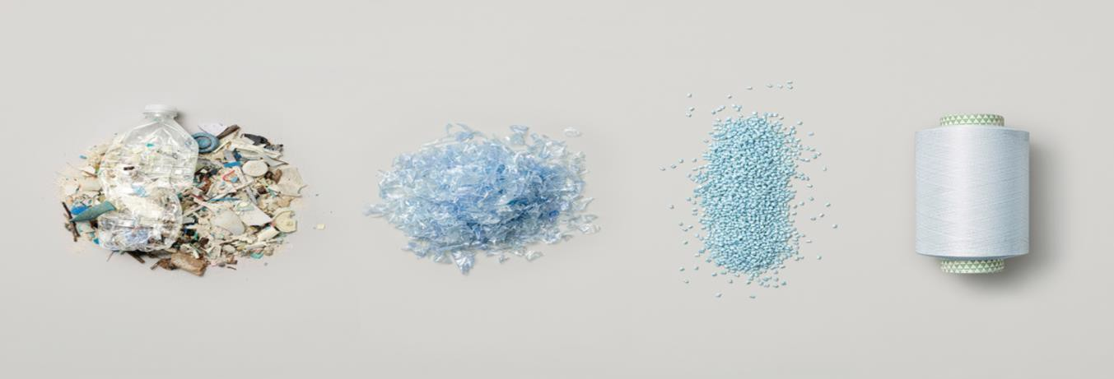
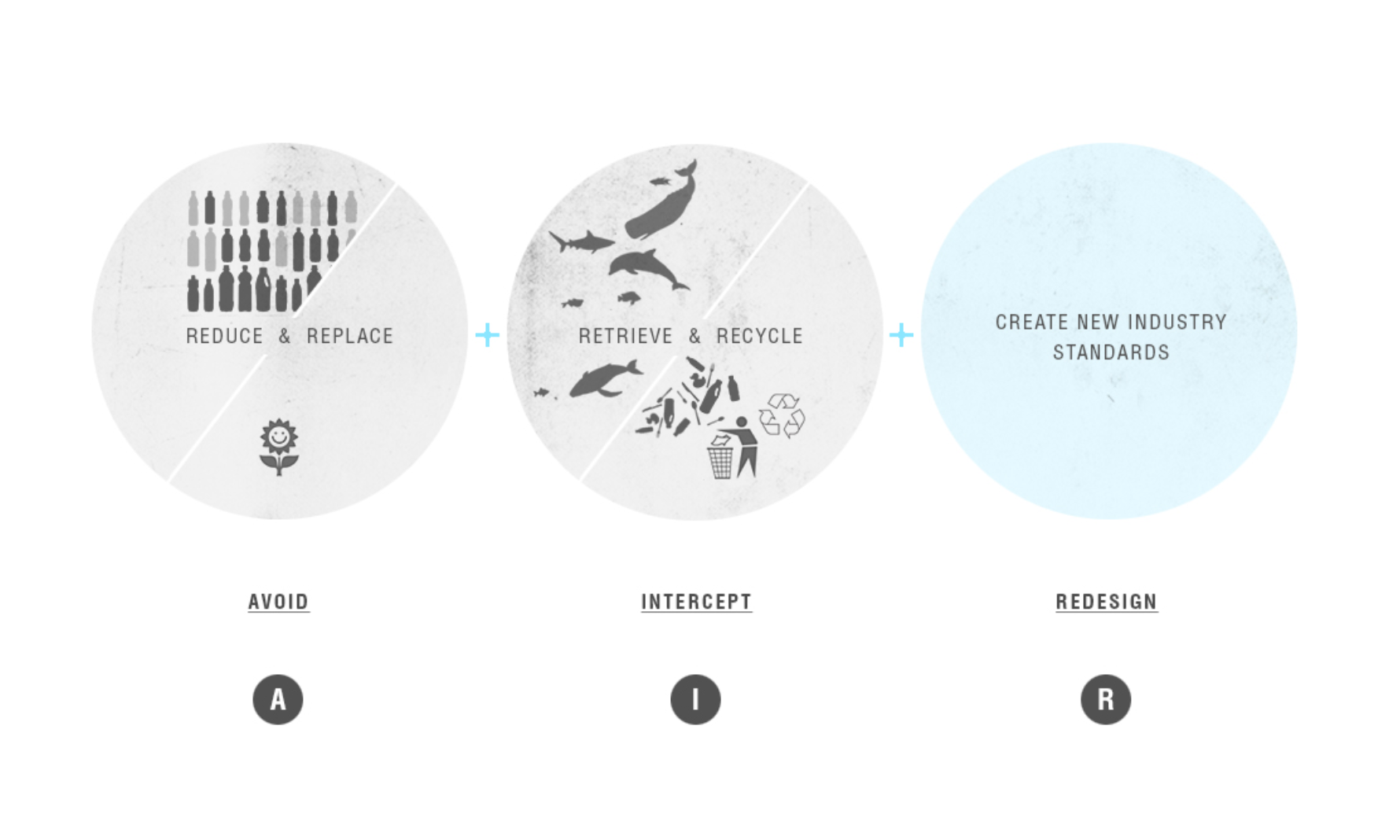
Introducing new fabrics through recycled marine waste
Our approach to turn products to symbols of change

Slide 10
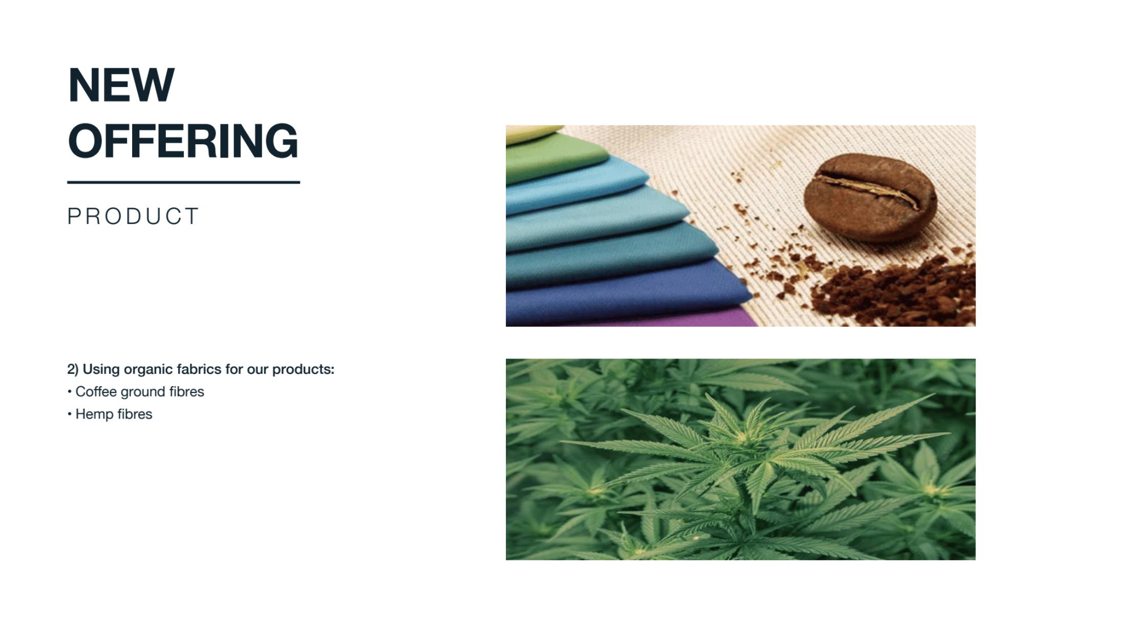
Using organic fabrics for our products
1. Coffee ground fibers
2. Hemp fibers

Slide 11
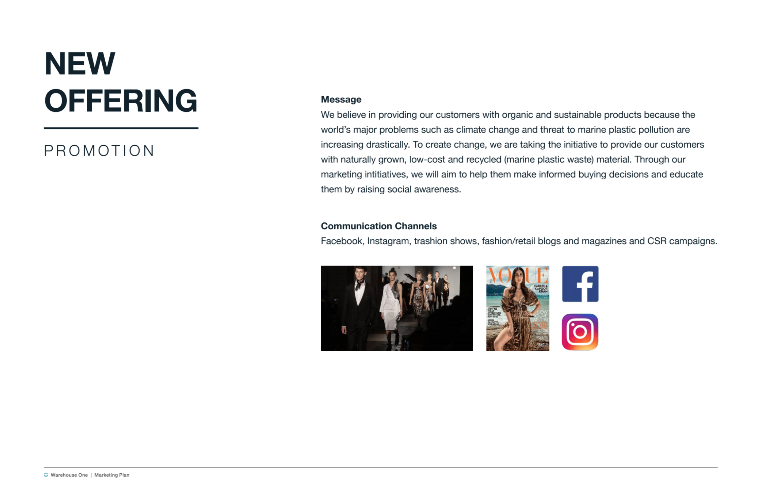





Message
We believe in providing our customers with organic and sustainable product because the world’s major problem such as climate change and thread to marine plastic pollution are increasing drastically.
To create a change, we are taking the initiative to provide our customers with naturally grown, low cost, and recycled material.
Through our marketing initiatives, we will aim to help them make in buying decisions and educate them by rising social awareness.
Communication Channels

Slide 12
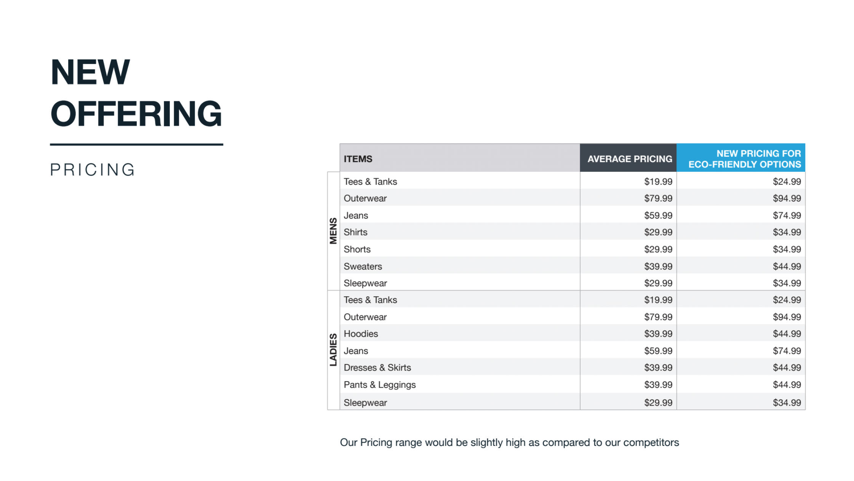

Slide 13
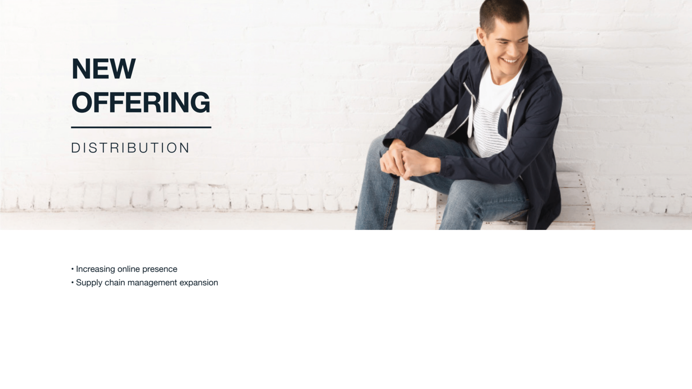
Increasing online presence
Supply chain management expansion

